Slide 1
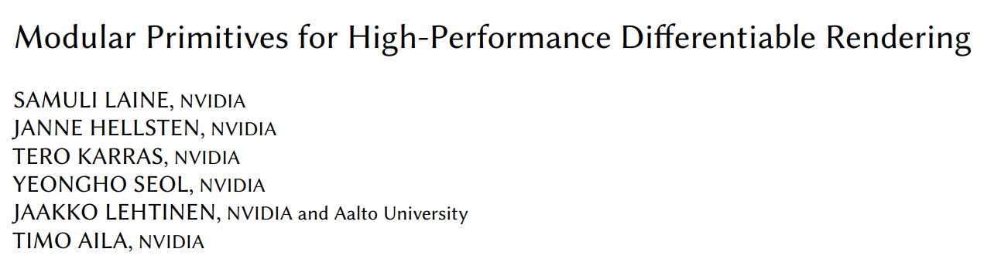
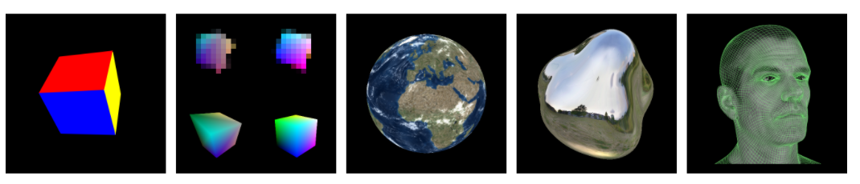
Zehao Yu
06/01/2021

Slide 2
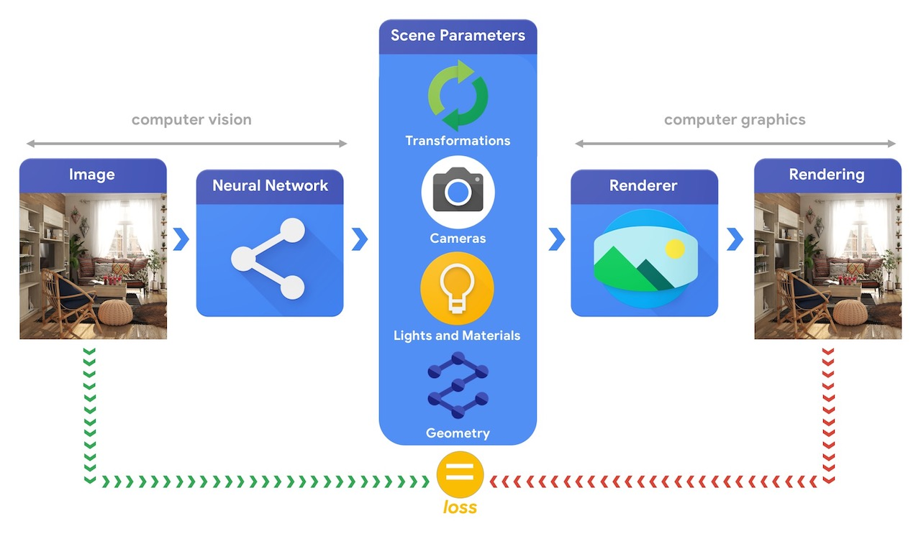
Motivation
https://github.com/tensorflow/graphics

Slide 3
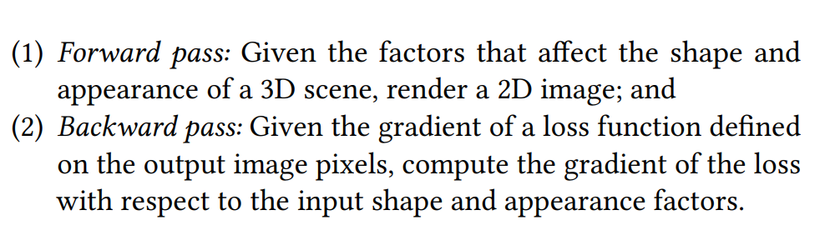
Motivation
Make use of real-time graphics systems with modular primitives.

Slide 4
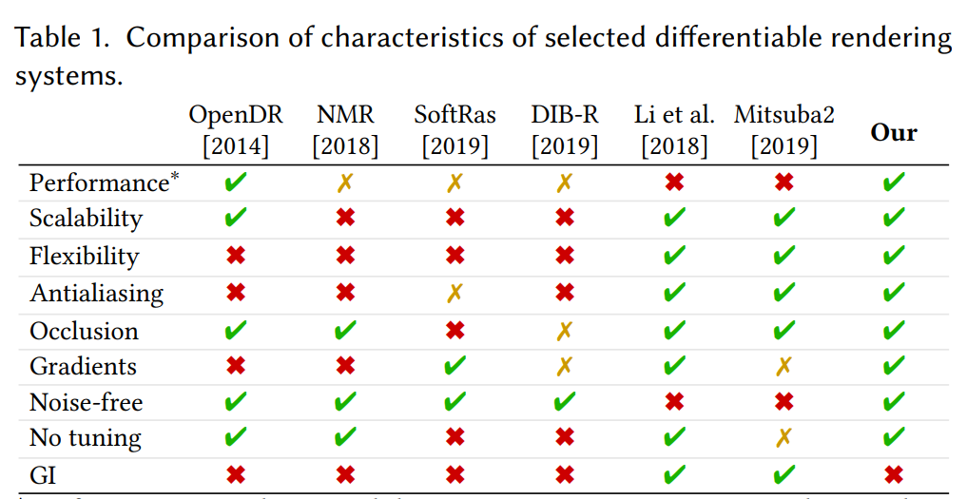
Related Work
Global Illumination

Slide 5
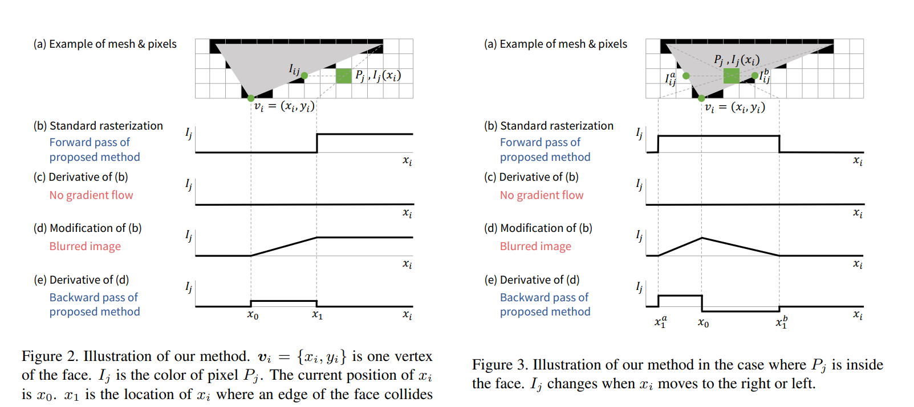
Related Work
Neural Mesh Renderer: hard designed approximate gradient, not correct, not scalable

Slide 6
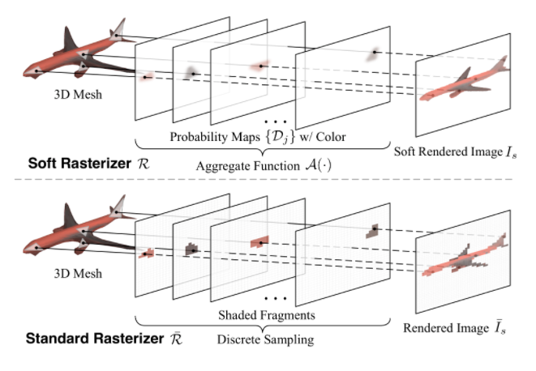
Related Work
Soft Rasterizer: gradients are affected by all faces regardless of occlusions, not scalable

Slide 7
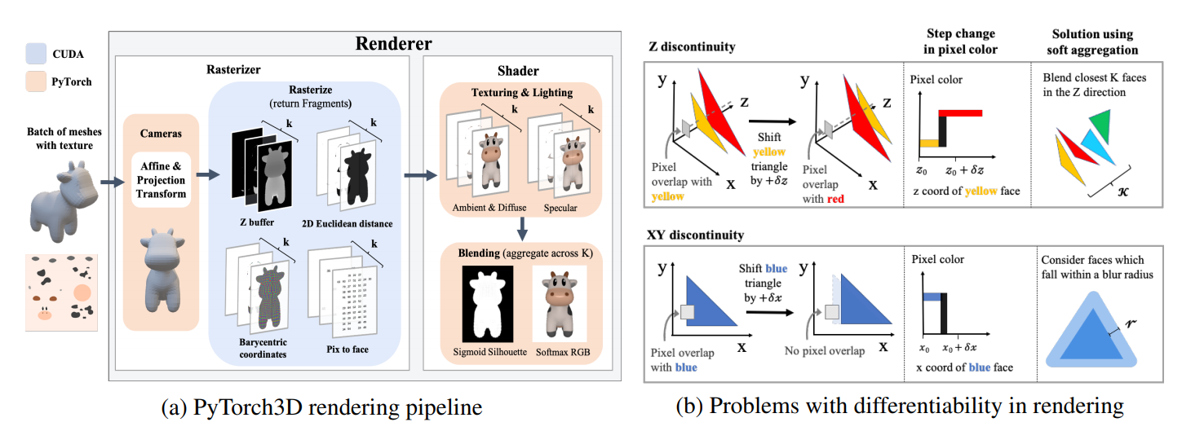
Related Work
Pytorch3D: similar with Soft-Rasterizer,
but with coarse to fine rasterization, also support point cloud rasterization,
also not scalable.

Slide 8
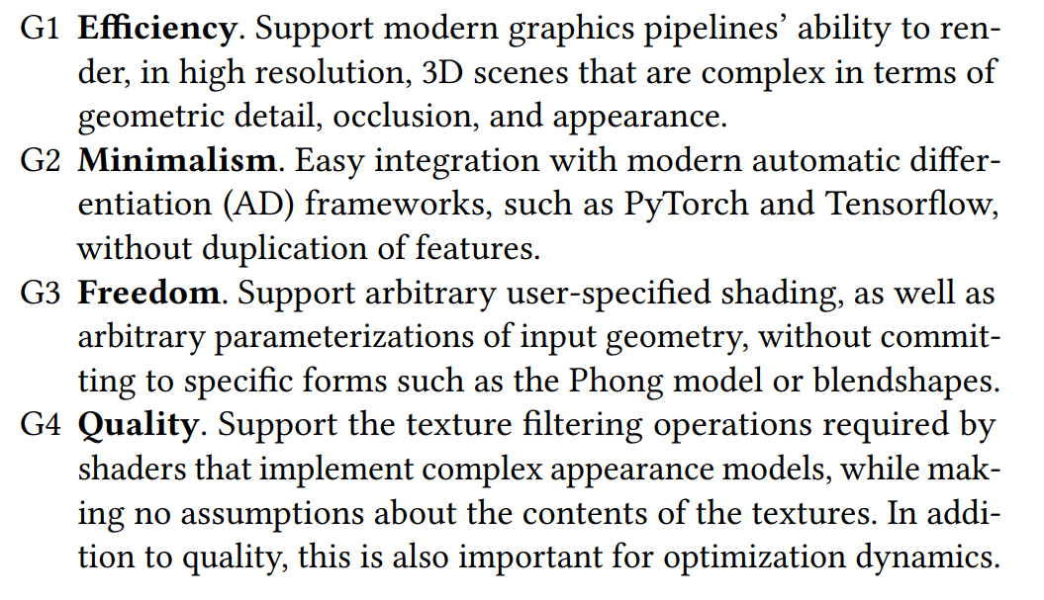
This Work- Design Goals

Slide 9
This Work – System Design
Modularity
Position and Textures are Tensors
Operate in Clip Space
Deferred Shading
Image-space Antialiasing
Triangles

Slide 10
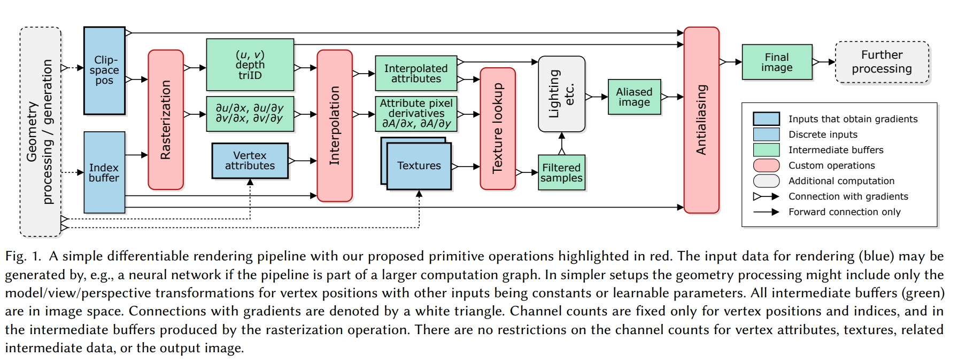
This Work – System Design

Slide 11
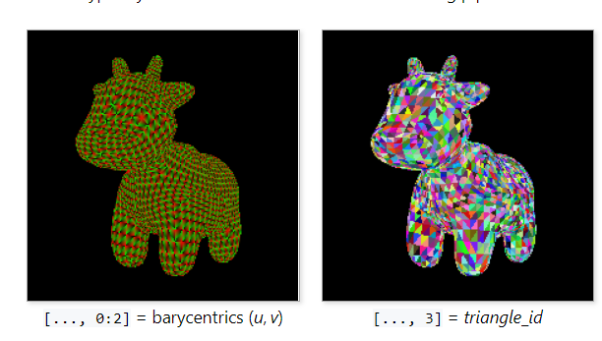
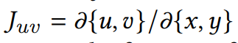
Modular Primitives – Rasterization
Input: vertex positions of clip-space
Output: face index, barycentric coordinate, Jacobian of barycentric w.r.t. screen coordinates
Use OpenGL and hardware graphics pipeline ensures that the rasterization is accurate and fast
(useful for texture lookup)

Slide 12
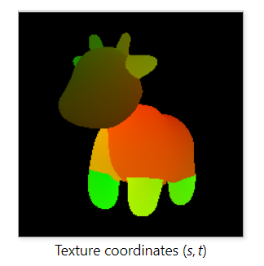
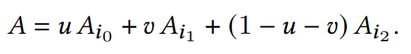
Modular Primitives – Interpolation
Input: barycentric coordinate (u, v, faceid) of pixel and vertex attribute
Output: Interpolated attributes at pixel

Slide 13
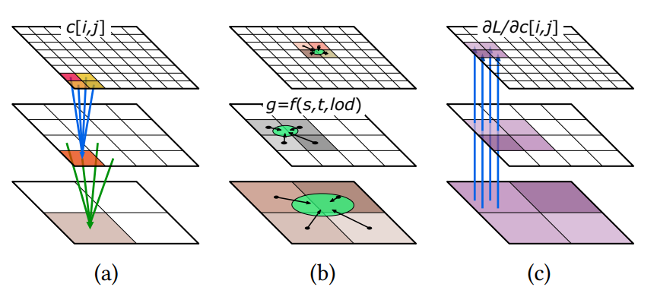
Modular Primitives – Texturing Mapping
Input: texture map, screen space derivatives
Output: sampled texture with MIP-map
https://sites.cs.ucsb.edu/~lingqi/teaching/resources/GAMES101_Lecture_09.pdf

Slide 14
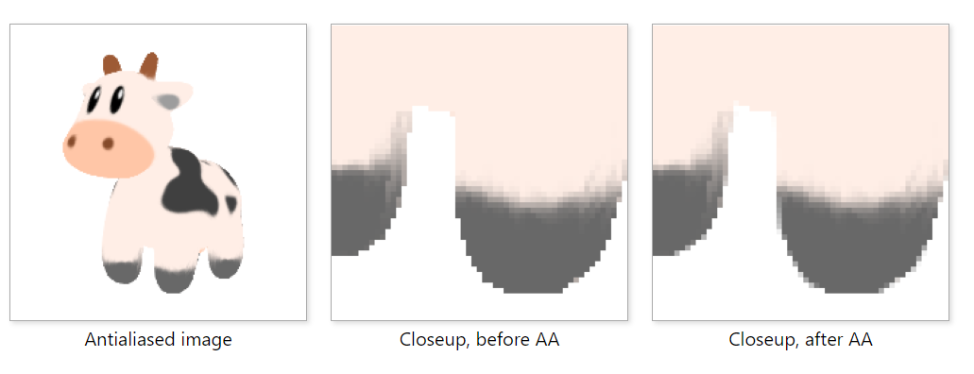
Modular Primitives – Antialiasing
Input: face index map, images
Output: anti-aliased image

Slide 15
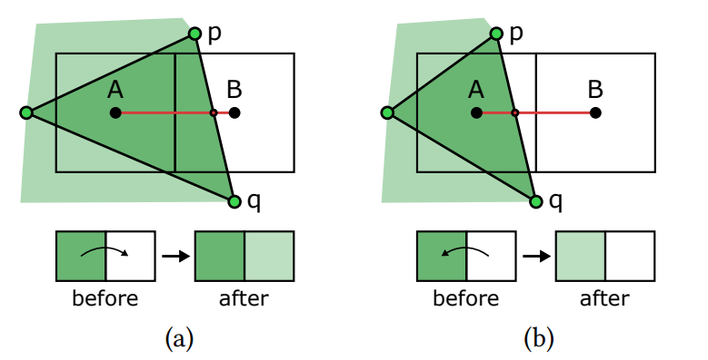
Modular Primitives – Antialiasing
Use face index map to detect discontinuity
Smooth out discontinuities based on a local approximation of coverage
For horizontal pixel pairs, only consider vertically oriented edges, and vice versa.

Slide 16
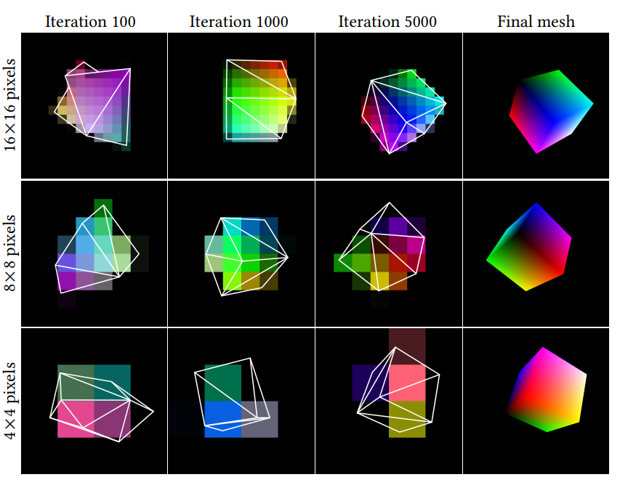
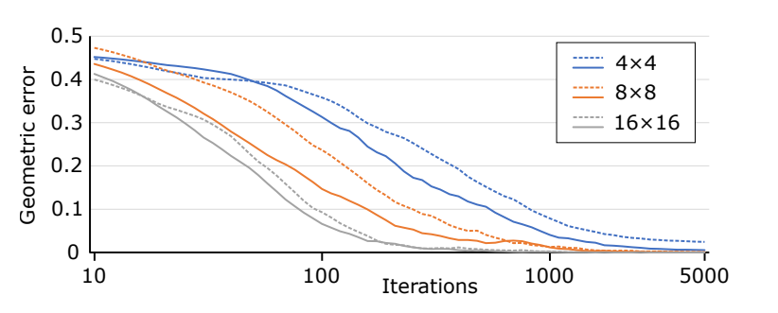
Experiments – Visibility Gradients
Optimize the vertex positions and colors of a cube mesh,
starting from a semi-randomly initialized state.
https://nvlabs.github.io/nvdiffrast/

Slide 17
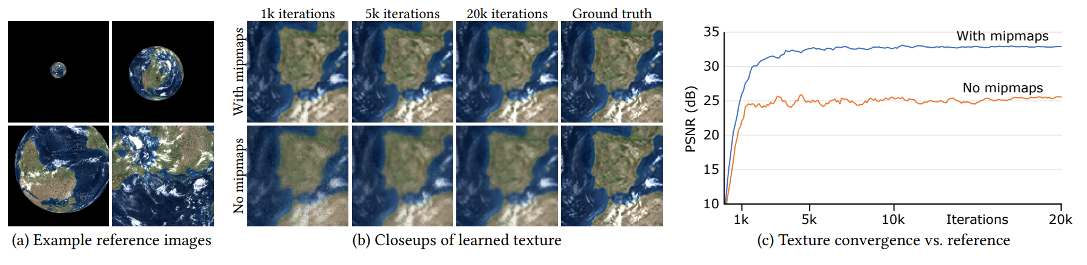
Experiments – Texture Filtering
Goals: Compare texture convergence with and without prefiltered texture sampling (MIP map)
Exp: Fixed Geometry, optimize texture map
https://nvlabs.github.io/nvdiffrast/

Slide 18
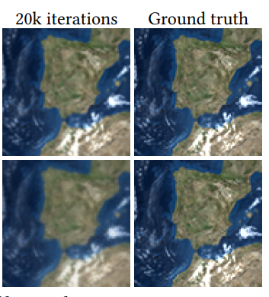
Experiments – Texture Filtering
Goals: Compare texture convergence with and without prefiltered texture sampling (MIP map)
Exp: Fixed Geometry, optimize texture map
https://nvlabs.github.io/nvdiffrast/

Slide 19
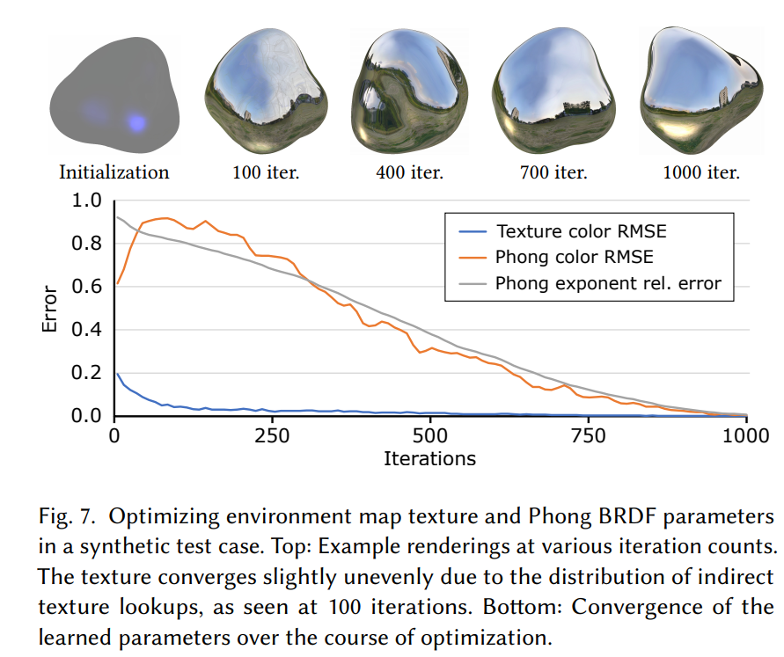
Experiments – Indirect Texturing, BRDF Optimization
Optimize Environment map and BRDF parameters based on reflections from object with know geometry and pose
https://nvlabs.github.io/nvdiffrast/

Slide 20
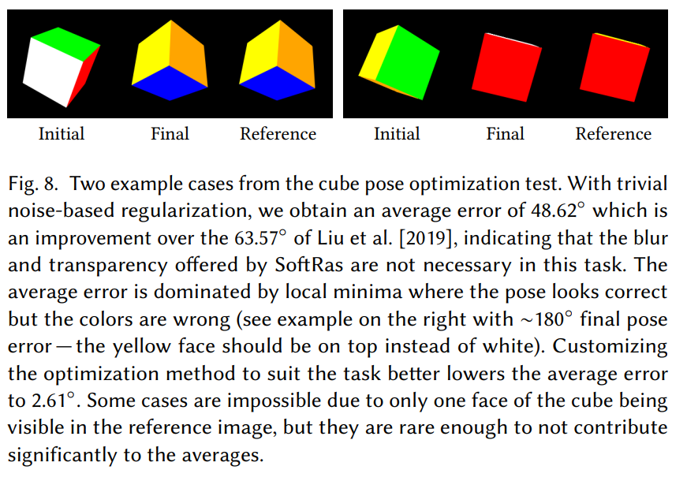
Experiments – Pose Optimization
Optimize pose of a rendered cube with image-space loss
Random noise in optimize
https://nvlabs.github.io/nvdiffrast/

Slide 21
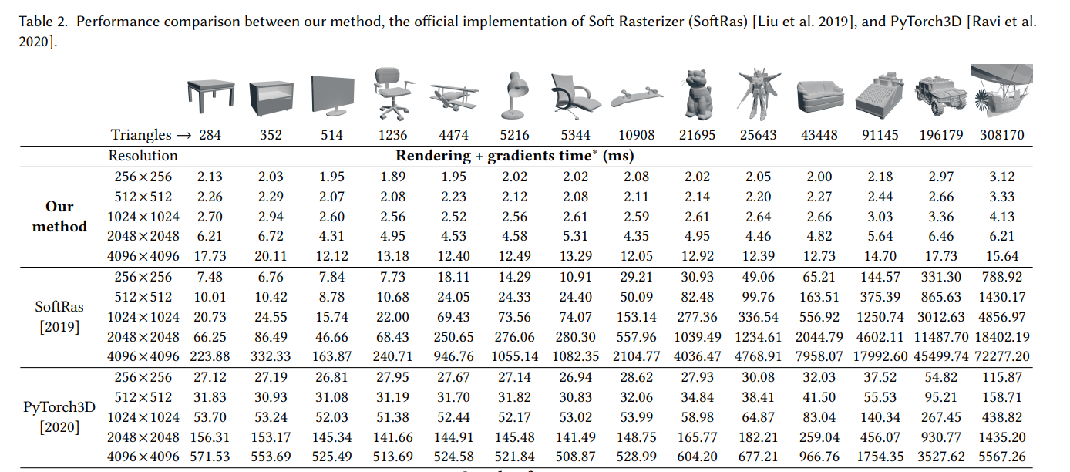
Experiments – Performance (Render time)
https://nvlabs.github.io/nvdiffrast/

Slide 22
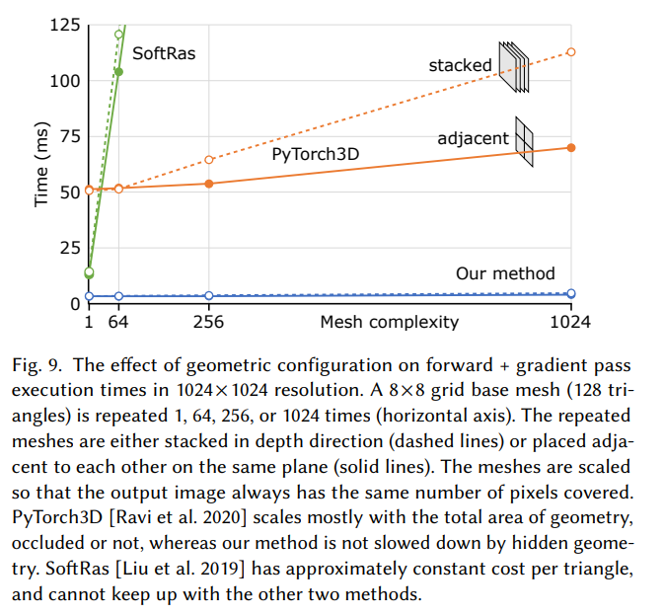
Experiments – Performance (Render time)
SoftRas: for pixel in pixels
for triangle in triangles
Pytorch3D: for patch in patches
for triangle in triangles
save faceid in sub patch
for pixel in pixels:
for triangle in patches
https://nvlabs.github.io/nvdiffrast/

Slide 23
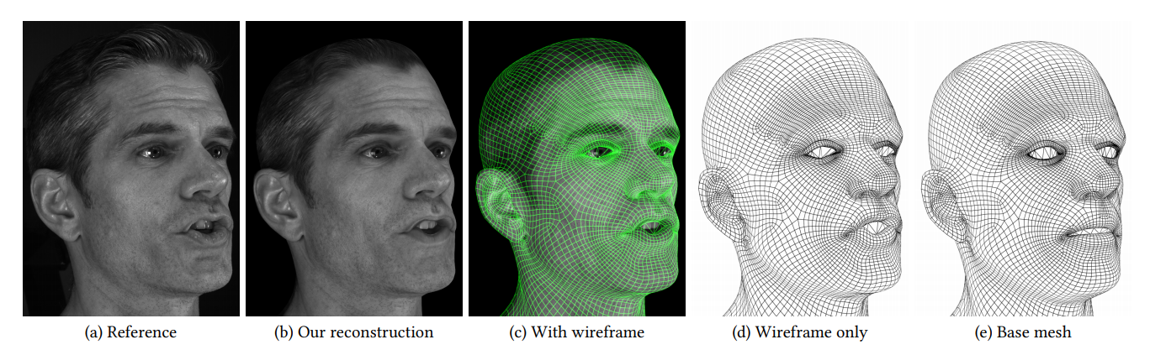
Experiments – Facial Performance Capture
Given: multi-views images of a sequence
Goals: estimate texture and per-frame deformation
Loss: reconstruction loss and Laplacian regularization
https://nvlabs.github.io/nvdiffrast/

Slide 24
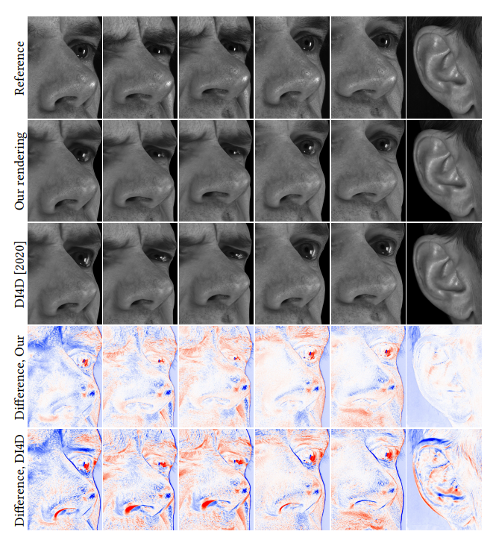
Experiments – Facial Performance Capture
Given: multi-views images of a sequence
Goals: estimate texture and per-frame deformation
Loss: reconstruction loss and Laplacian regualarization
https://nvlabs.github.io/nvdiffrast/

Slide 25
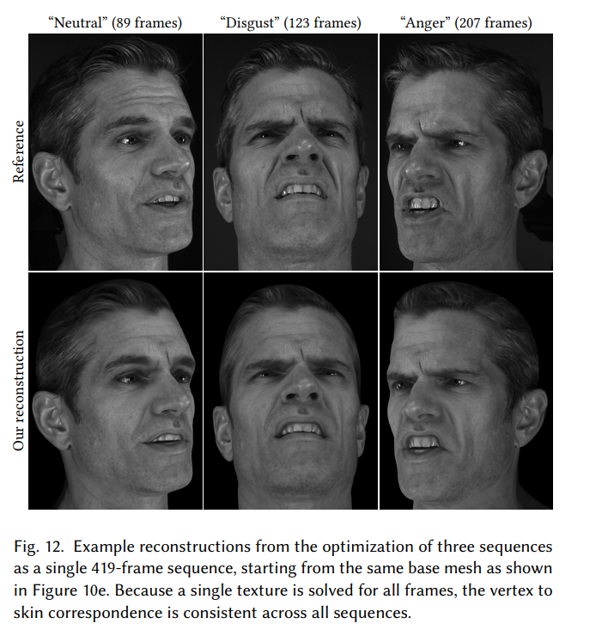
Experiments – Facial Performance Capture
Given: multi-views images of a sequence
Goals: estimate texture and per-frame deformation
Loss: reconstruction loss and Laplacian regualarization
Estimate rigid transformation between sequence
https://nvlabs.github.io/nvdiffrast/

